Slide 1



Kaggle Winner Caminito’s Team
Diego Passadore, MSc MBA
Federico Matorra, MD PhD
Argentina - July 2021
Notes:
Recommending picking out he most interesting and important parts from your documentation.

Slide 2
Agenda

Slide 3
Agenda
Background
Summary
Overall architecture
Step-by-step
Final Remarks
Q&A

Slide 4
Background

Slide 5
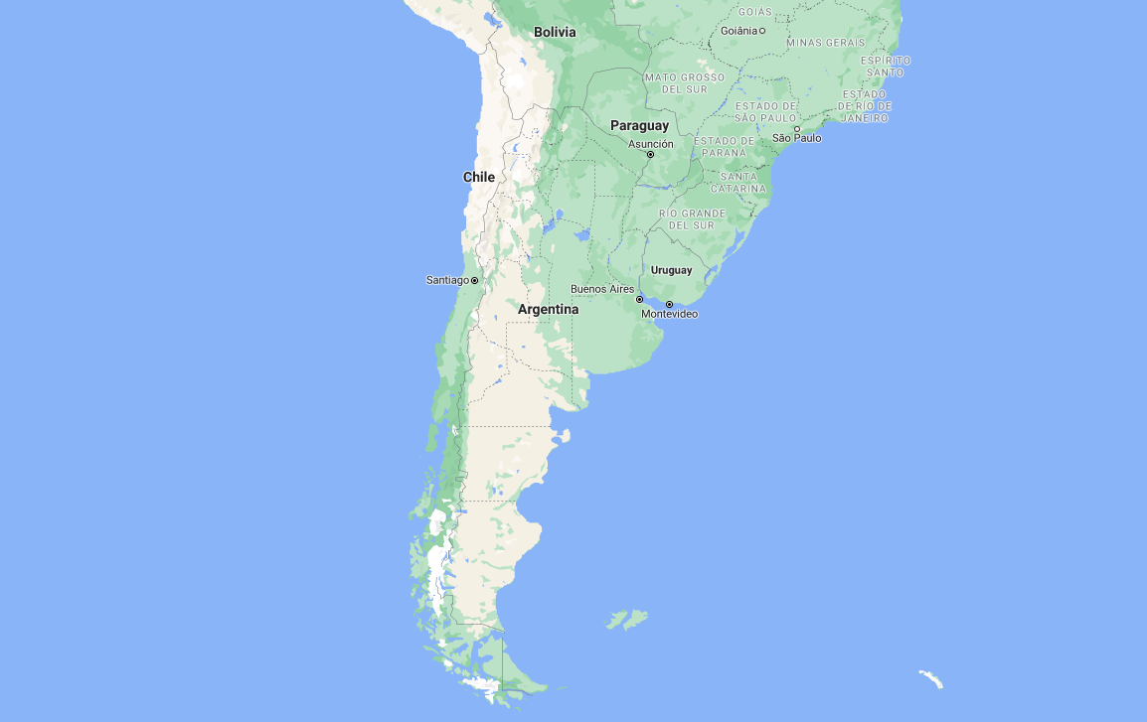
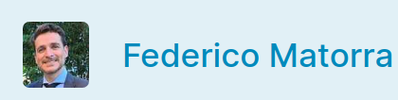

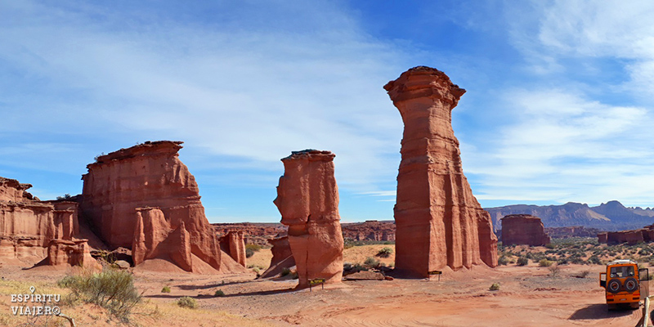
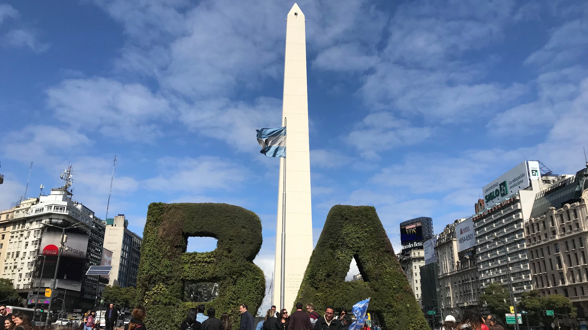

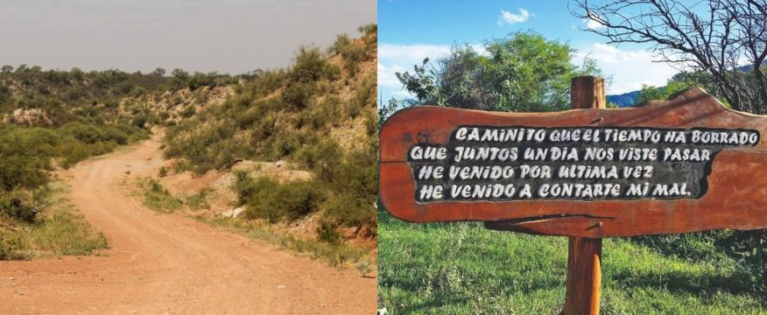
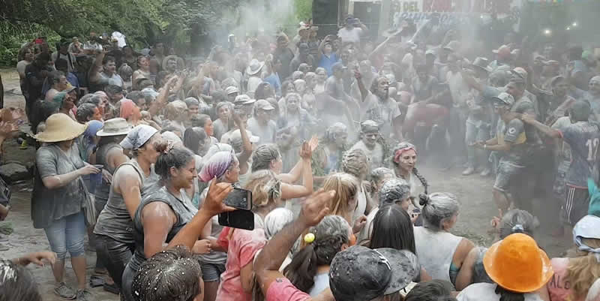

Background
La Rioja
Buenos Aires
Caminito’s Team - Tango Caminito

Slide 6
Background
Federico Matorra is an MD PhD, with a master's degree in clinical pharmacology and currently a candidate for a master’s degree in medical informatics.
Diego Passadore is a Nuclear Engineer (degree equivalent to a MSc), MBA and CEO of a non-profit organization with focus in medical imaging in Buenos Aires.
Both had their first experiences developing in NLP for specific tasks (tools for radiologists to aid in research and teaching) since a couple of years ago.
First time using Kaggle: Our aim was to keep learning and get to know new tools with the additional benefit of benchmarking.

Slide 7
Summary

Slide 8
Summary
Improve detection capabilities (search for unknown dataset names and enlarge LUT)
spaCy v2
Use NER and text classification for identifying dataset names
Use text classification for identifying sentences with dataset names

Slide 9
Summary
The basic approach relied on expanding the list of known dataset names (those provided with train.csv) to improve detection capabilities of models.
Model TEXTCAT_S for text classification: identify sentences including a dataset name versus sentences without any mention of a dataset.
Positive: The International Best Track Archive for Climate Stewardship (IBTrACS)
The IBTrACS database includes storm location and intensity observations (wind speed and central pressure) from up to 25 meteorological agencies and many storms have reports from multiple agencies.
Negative: Higher Education Price Index (HEPI)
All financial figures are in real 2007 dollars and are deflated by the Higher Education Price Index (HEPI).
Model TEXTCAT_D for text classification: identify dataset names versus texts that looked-like dataset names.
Dataset: Third International Mathematics and Science Study (TIMSS)
Not Dataset: Connecticut Department of Energy and Environmental Protection (CTDEEP)

Slide 10
Overall architecture

Slide 11
Preparing the data ...
Training models ...
Putting it all together ...
Text Cleaning
Text Cleaning
TEXTCAT_S (sentences)
spaCy sentences selection
spaCy sentences selection
Abbreviation detector and known dataset string matching
Manual selection of sentences and datasets
NER model
6th Place Notebook
Final Prediction
Sentences with similar words to dataset
TEXTCAT_S (sentences)
TEXTCAT_D (dataset)
NER model
Abbreviation detector and known dataset string matching
TEXTCAT_D (dataset)

Slide 12
Some more details ...

Slide 13
Preparing the data ...
Training models ...
Putting it all together ...
Text Cleaning
Text Cleaning
TEXTCAT_S (sentences)
spaCy sentences selection
spaCy sentences selection
Abbreviation detector and known dataset string matching
Manual selection of sentences and datasets
NER model
6th Place Notebook
Final Prediction
Sentences with similar words to dataset
TEXTCAT_S (sentences)
TEXTCAT_D (dataset)
NER model
Abbreviation detector and known dataset string matching
TEXTCAT_D (dataset)

Slide 14
Preparing the data ...
Text Cleaning:
Text Cleaning, preserving parentheses, brackets and periods, but removing the numbers in brackets.
E.g:
text_cleaning("Data were obtained from the Alzheimer's Disease Neuroimaging Initiative (ADNI) [3] database [adni.loni.usc.edu]... \n \t")
Output: 'Data were obtained from the Alzheimers Disease Neuroimaging Initiative (ADNI) database [adni.loni.usc.edu].'

Slide 15
Preparing the data ...
spaCy Sentence Segmentation:
A Doc object’s sentences are available via the Doc.sents property. Unlike other libraries, spaCy uses the dependency parse to determine sentence boundaries. This is usually more accurate than a rule-based approach, but it also means you’ll need a statistical model and accurate predictions.
E.g (https://v2.spacy.io/usage/linguistic-features#sbd):
import spacy
nlp = spacy.load("en_core_web_sm")
doc = nlp("This is a sentence. This is another sentence.")
for sent in doc.sents:
print(sent.text)
Output:
This is a sentence.
This is another sentence.

Slide 16
Preparing the data ...
spaCy Sentences with similar words to dataset:
Returns statements that contain dataset synonyms.
syn_dataset = ['dataset', 'datasets', 'data-set', 'data-sets', 'data sets', 'data set', 'datum', 'databases', 'database', 'data bank', 'data banks', 'databank', 'databanks', 'metadata', 'raw data', 'time series', 'time-series']
E.g-1:
"The AD dataset is composed of 120 subjects randomly drawn from the ADNI database.”
E.g-2:
“The educational datasets used in this analysis are the Integrated Postsecondary Education Data System (IPEDS) the Baccalaureate and Beyond 2008 2009 (B B) and the Career Technical Education (CTE) Statistics.”

Slide 17
Preparing the data ...
Abbreviation detector and known dataset string matching:
The AbbreviationDetector is a Spacy component which implements the abbreviation detection algorithm in "A simple algorithm for identifying abbreviation definitions in biomedical text.", (Schwartz & Hearst, 2003).
You can access the list of abbreviations via the doc._.abbreviations attribute and for a given abbreviation. scispaCy (https://github.com/allenai/scispacy)
known dataset string matching (spaCy entity-ruler)
E.g:
doc = nlp(“The educational datasets used in this analysis are the Integrated Postsecondary Education Data System (IPEDS) the Baccalaureate and Beyond 2008 2009 (B B) and the Career Technical Education (CTE) Statistics.”)
for abrv in doc._.abbreviations:
print(f"{abrv} | {abrv._.long_form}")
Output: IPEDS | Integrated Postsecondary Education Data System
Output: CTE | Career Technical Education

Slide 18
Preparing the data ...
Training models ...
Putting it all together ...
Text Cleaning
Text Cleaning
TEXTCAT_S (sentences)
spaCy sentences selection
spaCy sentences selection
Abbreviation detector and known dataset string matching
Manual selection of sentences and datasets
NER model
6th Place Notebook
Final Prediction
Sentences with similar words to dataset
TEXTCAT_S (sentences)
TEXTCAT_D (dataset)
NER model
Abbreviation detector and known dataset string matching
TEXTCAT_D (dataset)

Slide 19

Manual selection of sentences and datasets
Reading sentences and selecting datasets:
We analyzed ~7000 papers and got sentences with known and some unknown datasets.
On the other hand, we also found a large number of acronyms that we did not know if they were datasets or not.
We invested approximately 20 days analysing ~5000 new candidate datasets to get reliable data to train our named entities recognition model.
Finally we chose 1093 sentences, 1013 positive for datasets and 80 negative, in order to train a NER model and feed the TEXTCAT_S.
E.g:
Positive | Negative
All sMRI and cognitive score data used for evaluation of the architecture were obtained from the Alzheimers Disease Neuroimaging Initiative (ADNI) database (http adni.loni.usc.edu). | Then we split the dataset into training set with 16 samples, validation set with 4 samples and testing set with the remaining 20 samples.

Slide 20
Preparing the data ...
Training models ...
Putting it all together ...
Text Cleaning
Text Cleaning
TEXTCAT_S (sentences)
spaCy sentences selection
spaCy sentences selection
Abbreviation detector and known dataset string matching
Manual selection of sentences and datasets
NER model
6th Place Notebook
Final Prediction
Sentences with similar words to dataset
TEXTCAT_S (sentences)
TEXTCAT_D (dataset)
NER model
Abbreviation detector and known dataset string matching
TEXTCAT_D (dataset)

Slide 21
Training models ...
TEXTCAT_S (sentences):
With a semi-automatic approach, we selected sentences positives for containing a mention to a dataset and negatives for not including dataset names.
The result was a set of approximately 28,000 sentences, of which 13,832 were positives and 14,167 negatives.
TextCategorizer: convolutional neural network text classifier.
Model: thinc.neural.Model
Architecture: ensemble
E.g:
Positive | Negative
Longitudinal data from the Massachusetts Male Aging Study (MMAS) indicate that the prevalence of symptomatic androgen deficiency (Total testosterone 300 ng dL) in men aged between 40 69 years is between 6 and 12. | We define innovation-intensive industries as those where the probability of the 75th quantile establishment being a substantive innovator is 60 percent or greater.

Slide 22
Training models ...
NER model:
We use 1093 sentences, 1013 positive for datasets and 80 negative.
Some statements contained 1 or more datasets.
Pre-trained model of spaCy (en_core_web_sm) was used as the base model for transfer learning.
We used Word2Vec vectors created with Gensim (138,671 tokens, Dims: 50, Window: 11, min freq: 7).
E.g:
doc = nlp(“The educational datasets used in this analysis are the Integrated Postsecondary Education Data System (IPEDS) the Baccalaureate and Beyond 2008 2009 (B B) and the Career Technical Education (CTE) Statistics.”)
for ent in doc.ents:
print(ent)
Output: Integrated Postsecondary Education Data System (IPEDS)
Output: Baccalaureate
Output: Career Technical Education (CTE)

Slide 23
Training models ...
TEXTCAT_D (Dataset):
Identify dataset names versus texts that looked-like dataset names.
1191 Datasets and around 2500 organizations, locations, etc (Not Dataset). were used.
TextCategorizer: convolutional neural network text classifier.
Model: thinc.neural.Model
Architecture: ensemble
E.g:
DATASET | Not DATASET
Womens Genome Health Study Canadian Longitudinal Study on Aging Program on International Reading Literacy Study cas covid 19 antiviral candidate compounds dataset | Advanced NASA Technology Architecture for Exploration Studies Boston Area Community Health California Basic Education Data System Committee on National Statistics

Slide 24
Preparing the data ...
Training models ...
Putting it all together ...
Text Cleaning
Text Cleaning
TEXTCAT_S (sentences)
spaCy sentences selection
spaCy sentences selection
Abbreviation detector and known dataset string matching
Manual selection of sentences and datasets
NER model
6th Place Notebook
Final Prediction
Sentences with similar words to dataset
TEXTCAT_S (sentences)
TEXTCAT_D (dataset)
NER model
Abbreviation detector and known dataset string matching
TEXTCAT_D (dataset)

Slide 25
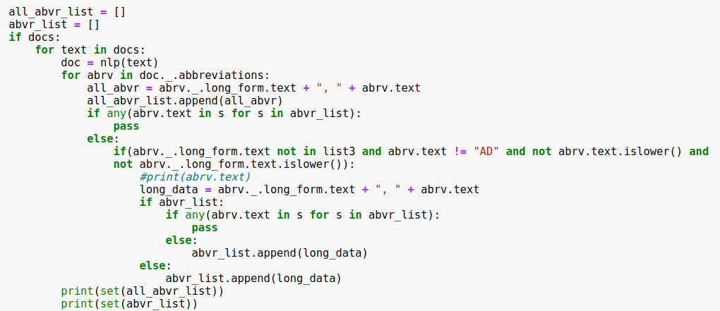
Features Selection/Engineering
Working on the prediction code (example 1):
Fourth test file
id: 8e6996b4-ca08-4c0b-bed2-aaf07a4c6a60
Text sample: [‘Introduction. A significant body of research has been conducted in the past two decades to understand how consumers decide where to shop and the types of foods they purchase. Even though lowincome (LI) households choices are constrained by financial barriers their decisions about where to shop for food are similar to those of non low income (NLI) households...’]
Words in text: 48476
Sentences in text: 388
Abbreviation List (scispaCy)
{'Rural Urban Continuum Codes, RUCCs', 'Economic Research Service, ERS', 'Consumer Network Panel, CNP', 'non low income, NLI', 'low income low access, LILA', 'Information Resource Incorporated, IRI', 'Food Marketing Institute 2015, FMIs', 'lowincome, LI', 'milk regular beef white bread, MBI', 'Northeast, NE', 'market basket items, MBIs', 'stores, stores', 'Consumer Expenditure Survey, CES', 'National Bureau of Economic Research, NBER', 'Nielson 2017). African American consumers bought poultry more frequently than any other group, Nielson 2017', 'Food Marketing Institute, FMI'}
{'Rural Urban Continuum Codes, RUCCs', 'Economic Research Service, ERS', 'Consumer Network Panel, CNP', 'non low income, NLI', 'low income low access, LILA', 'Information Resource Incorporated, IRI', 'Food Marketing Institute 2015, FMIs', 'lowincome, LI', 'milk regular beef white bread, MBI', 'Northeast, NE', 'market basket items, MBIs', 'stores, stores', 'Consumer Expenditure Survey, CES', 'National Bureau of Economic Research, NBER', 'Nielson 2017). African American consumers bought poultry more frequently than any other group, Nielson 2017', 'Food Marketing Institute, FMI'}
{'Rural Urban Continuum Codes, RUCCs', 'Consumer Network Panel, CNP', 'Information Resource Incorporated, IRI', 'Food Marketing Institute 2015, FMIs', 'Northeast, NE', 'Consumer Expenditure Survey, CES', 'National Bureau of Economic Research, NBER', 'Nielson 2017). African American consumers bought poultry more frequently than any other group, Nielson 2017', 'Food Marketing Institute, FMI'}

Slide 26
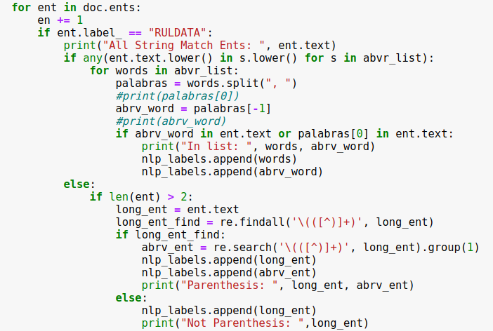
Features Selection/Engineering
Working on the prediction code (example 2):
Fourth test file
id: 8e6996b4-ca08-4c0b-bed2-aaf07a4c6a60
Sentences in text: 388
Entity Ruler (String Matching - spaCy)
All String Match Ents: Rural Urban Continuum Codes, National Health and Nutrition Examination Survey.
In Abbreviation list: Rural Urban Continuum Codes, RUCCs
Not Parenthesis: National Health and Nutrition Examination Survey

Slide 27
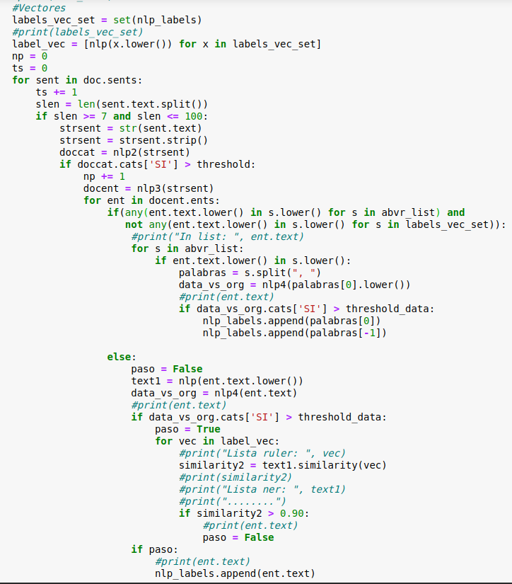
Features Selection/Engineering
Working on the prediction code (example 3):
test file | id: 8e6996b4-ca08-4c0b-bed2-aaf07a4c6a60 | Sentences in text: 388
NER-TEXTCAT (spaCy)
The generated vectors are used to discard repeated datasets between string matching and the NER model.
Here we use TEXTCAT_S model. Threshold = 90%
12 sentences were classified as positive from 388.
E.g:
Participants county of residence was linked with the USDA (2013) Rural Urban Continuum Codes (RUCCs)
What We Eat in America methodology used in the National Health and Nutrition Examination Survey national food survey (USDA 2016).
The analysis of the CES data utilized food categories.
We dive through the sentences with spaCy and those with up to 100 words are selected
So here we use the long form of the Abrv list and pass it through the TEXTCAT_D, if the threshold is greater than 95%, we keep the dataset.
DATASET found
print(data_vs_org, data_vs_org.cats['SI'])
['CES', 'Consumer Expenditure Survey'] - 99%
['IRI', 'Information Resource Incorporated'] - 15%
Finally, our positive datasets were:
{'rural urban continuum codes ruccs', 'ruccs', 'consumer expenditure survey', 'ces', 'national health and nutrition examination survey'}
Here we use NER model.
NER found
CES (CES was not on the ruler list, but it was on the Abrv list)
IRI (same as above)
Rural Urban Continuum Codes
National Health and Nutrition Examination Survey
All String Match Ents: Rural Urban Continuum Codes, National Health and Nutrition Examination Survey.

Slide 28
UseNER and text classification for identifying dataset names
Final Prediction
Submission and Description | Status | Private Score | Public Score
Abrv_Ruler_Model SinNER_igual_al_anterior | Succeeded | 0.355 | 0.598
Abrv_Ruler_Model NER-TEXCAT-SENTENCES | Succeeded | 0.147 | 0.585
TextCat-NER ner_ruler_por_separado | Succeeded | 0.414 | 0.558
TextCat-NER final_ajustoModelo (version 8/9) | Succeeded | 0.478 | 0.563
Text Cleaning
spaCy sentences selection
Abbreviation detector and known dataset string matching
Final Prediction
TEXTCAT_S (sentences)
NER model
TEXTCAT_D (dataset)

Slide 29
Final Remarks

Slide 30
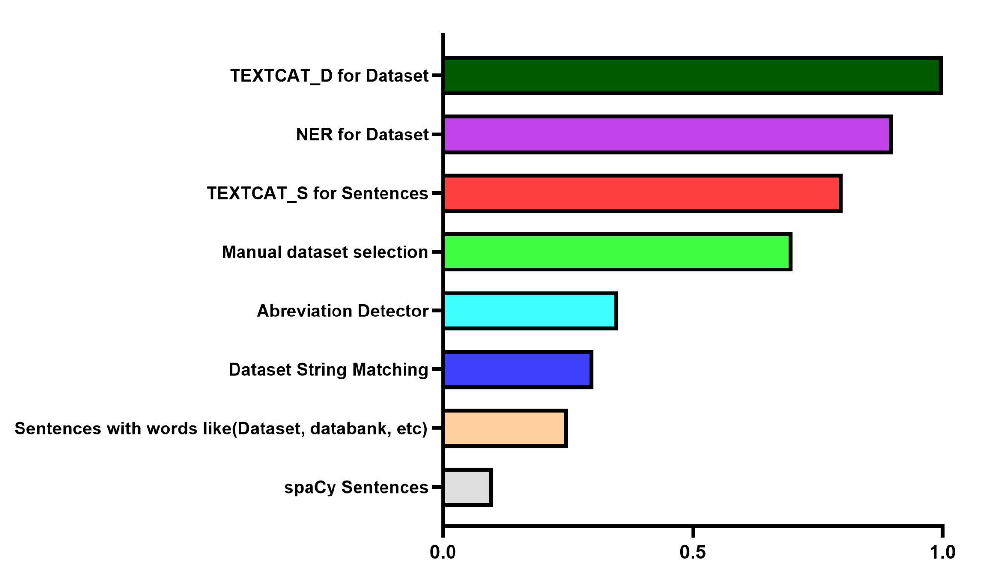
Features Selection/Engineering
Features Selection/Engineering
Variable Importance Plot
Variable Importance (qualitative analysis):

Slide 31
What made a difference in our case?
The overall approach was laborious but simple and fast to deploy and train
Maybe our background in reading scientific articles
We had some limitations with respect to available tools, so the only alternative is trying to be creative and explore different scenarios
Federico did a great job in expanding the list of dataset names (patience and commitment)
Kaggle Winner Presentation Template

Slide 32
What is lacking in our case?
Be careful when choosing how to start with the platform (it was a difficult challenge)
Select a few papers from PubMed to use as private test set
Improve the way we approach the problem if we want to be efficient in using our time
Better quantitative and graphical analysis of the contribution of each step in the final results
Identification of important features
Take advantage of the generosity of others who share their notebooks and incorporate improvements on top
Kaggle Winner Presentation Template

Slide 33




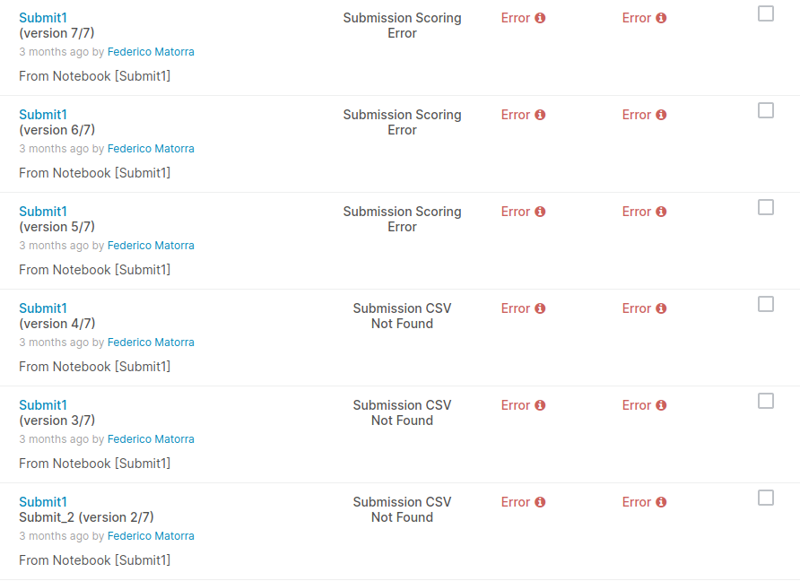

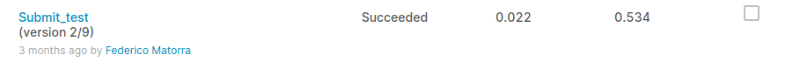
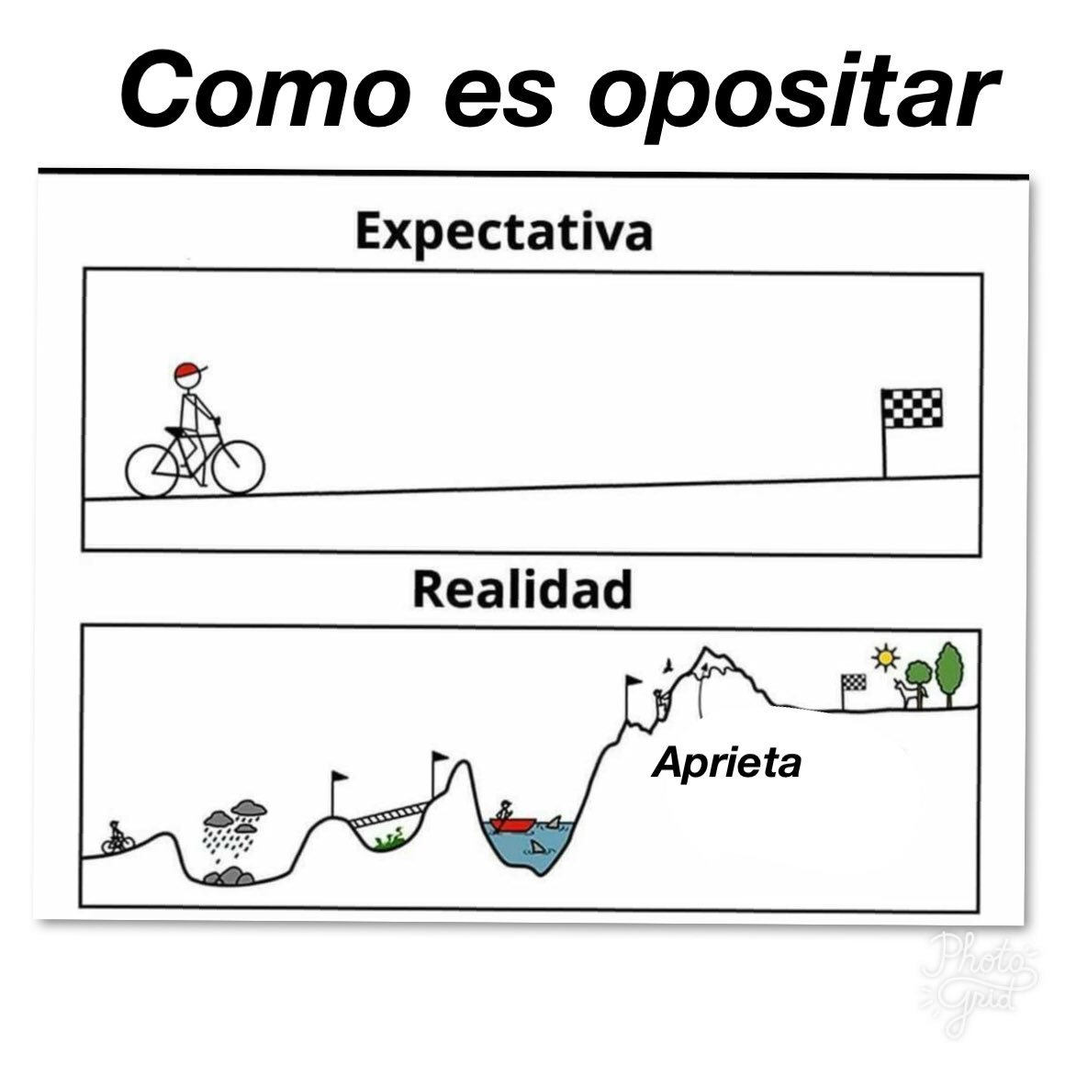

Features Selection/Engineering
Our little path (Caminito):
NER, VECTORS, TEXTCAT for sentences, SEARCHING FOR MORE DATASETS
Continuing to do "more of the same", even though there might be improvements, might be self-defeating.
Yeah… String Matching
Jumping from position 350 to 50
Expectation
A few days before the competition ended, the idea of using TEXTCAT to classify Datasets came up
NOW...
Reality

Slide 34
Thank you!

Slide 35
Questions and Answers

